Slide 1

TELECOM CUSTOMER CHURN PREDICTION
Under the Guidance of:
Dr. Chaojie Wang
DATA-606 - Capstone in Data Science
Submitted By:
Sreesai Sameera Koppana (QT11938)

Slide 2

PROJECT WORKFLOW
What is Customer Churn?
Why does Customer Churn Matter?
Research Questions
Exploratory Data Analysis
Recovering Missing Values
Summary Statistics
Data Visualization
Data preprocessing
Correlation of Features w.r.t Churn
Evaluation Models
Deployment
Conclusion
References

Slide 3

What is Customer Churn?
Customer churn, also known as customer turnover, is when customers discontinue their services from a provider or frim.
Churn is a critical metric for businesses as it directly affects revenue and profitability.
Customer churn can result from dissatisfaction with product or service quality, poor customer service experiences, competitive offerings, pricing changes, or changes in customer needs or preferences.
To decrease churn, businesses can take proactive steps like improving product quality, enhancing customer support, implementing loyalty programs, offering personalized incentives, and using data analytics to identify and address churn drivers.

Slide 4

Why Does Customer Churn Matter?
Essential for Revenue: Customers are essential for generating revenue and sustaining the business.
Driving Growth: Satisfied customers often become repeat customers and advocates for the brand, driving growth through positive word-of-mouth referrals and repeat purchases.
Feedback and Improvement: Customers provide valuable feedback that helps businesses understand their needs and preferences, essential for product/service improvement.
Competitive Advantage: Customer satisfaction and loyalty can provide a competitive advantage in the marketplace, helping businesses stand out from competitors and retain market share.Kaggle

Slide 5

Research Questions
What's the % of Churn Customers and customers that keep in with the active services?
Is there any patterns in Churn Customers based on the gender?
Is there any patterns/preference in Churn Customers based on the type of service provided?
What's the most profitable service types?
Which features and services are most profitable?

Slide 6

Exploratory Data Analysis

Slide 7
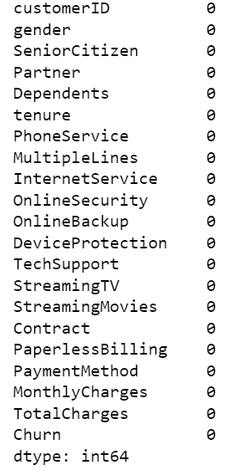
1. Recovering Missing Values
During data cleaning, 11 missing values were identified in the 'TotalCharges' column, while 'tenure' values were observed as 0 despite 'MonthlyCharges' containing non-empty values. These entries were removed to ensure data integrity. Subsequently, the dataset is now deemed clean and suitable for analysis.

Slide 8
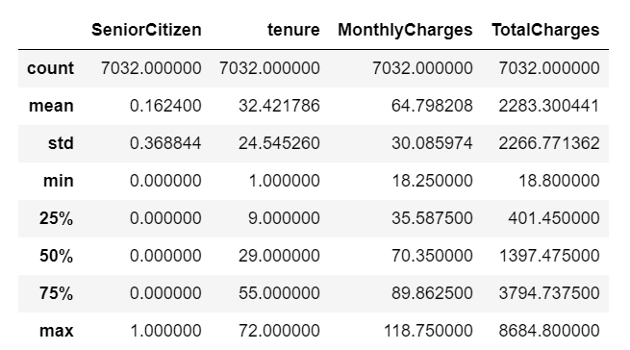
2. Summary Statistics

Slide 9
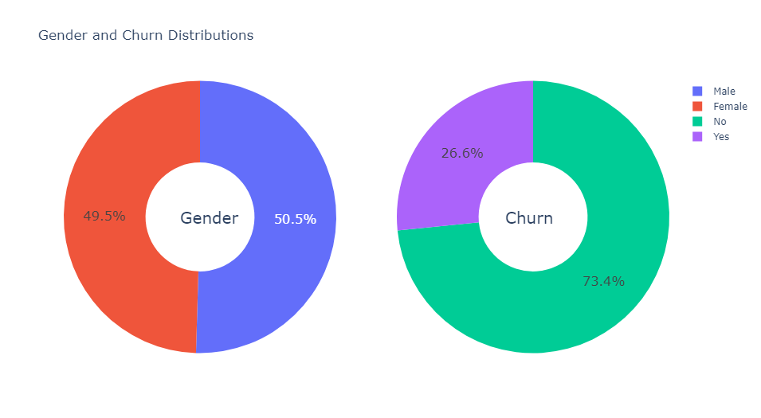
3. Data Visualization
Gender and Churn Distributions:
Male: 50.5%
Female: 49.5%
Churn: 26.6%
No-Churn: 73.4%

Slide 10
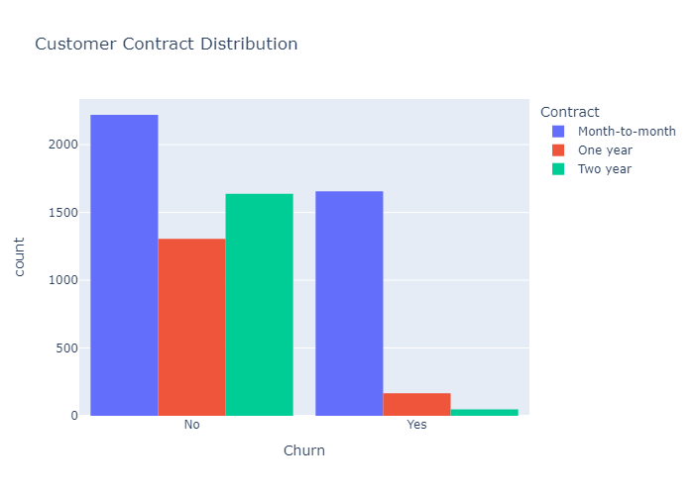
2. Customer Contract Distribution:
Month-to-Month has the highest churn and no-churn rate, followed by One-year and Two-year contracts.

Slide 11
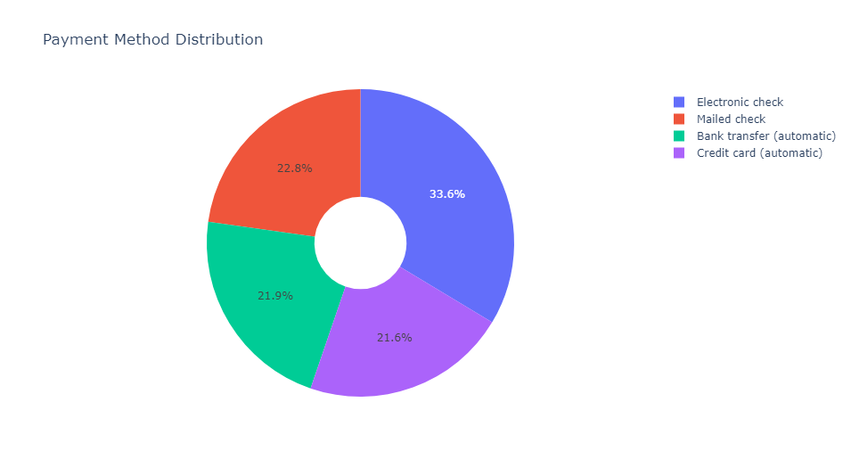
3. Payment Method Distribution:
Electric Check: 33.6%
Mailed Check: 22.8%
Bank Transfer (automatic): 21.9%
Credit Card (automatic): 21.6%

Slide 12
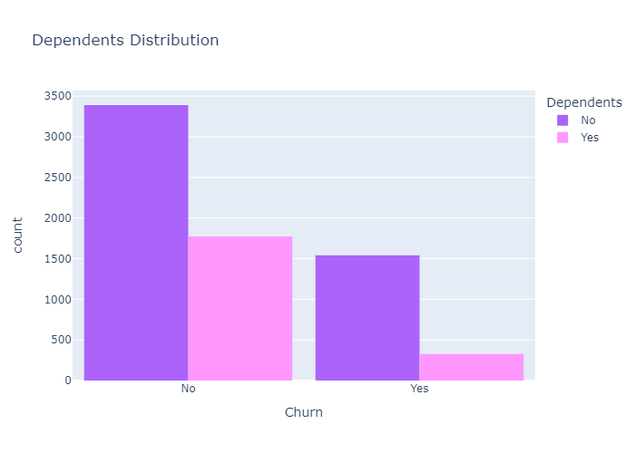
4. Dependents Churn Distribution:
Customers without dependents are more likely to churn compared to those with dependents.
Conversely, a higher proportion of customers without dependents are retaining the service compared to those with dependents.

Slide 13
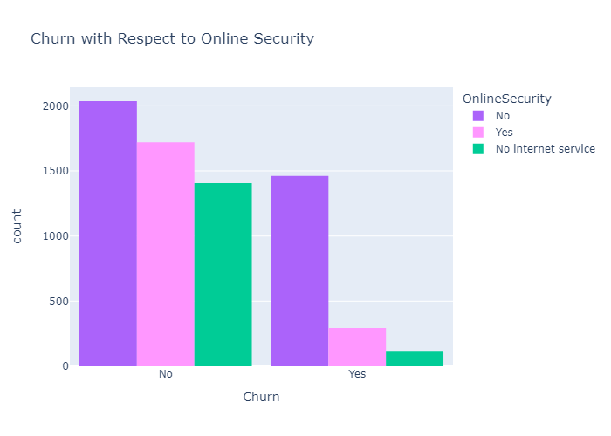
5. Churn w.r.t Online Security:
Customers lacking online security features exhibit a higher tendency to churn, emphasizing the importance of such provisions in retention efforts.
Interestingly, both customers with and without online security demonstrate a willingness to continue with the service, suggesting additional factors influencing their decision-making beyond this feature alone.

Slide 14

Data Preprocessing

Slide 15

Preprocessing:
Encoded object-type variables to integers using LabelEncoder.
Standardized numerical features with StandardScaler.
Data Categorization:
Segmented data into three groups: numerical columns, categorical columns for One-Hot Encoding, and categorical columns for Label Encoding.
Scaling:
Applied StandardScaler to both training and testing sets for consistent scaling.
Class Balance Verification:
Examined churn and no-churn counts to ensure a balanced dataset for unbiased model evaluation and decision-making.

Slide 16
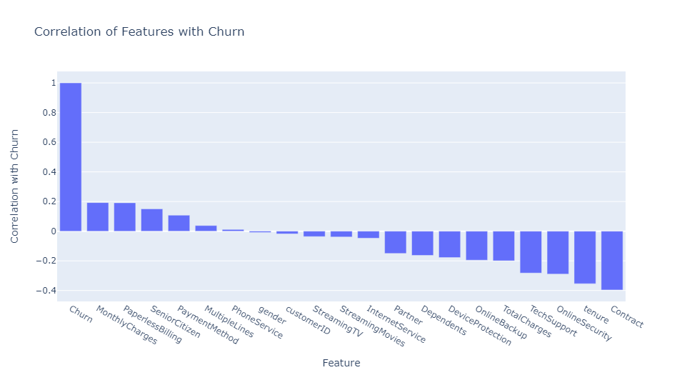
Correlation of Features w.r.t Churn
Higher Spending Features:
Customers with longer contract tenures and higher total or monthly charges are more likely to churn, indicating a potential mismatch between these plans and customer needs.
Additional Service Usage:
Customers utilizing services such as online security, phone service, and multiple phone lines show lower churn rates, suggesting a positive impact on customer satisfaction and loyalty.

Slide 17

Evaluation Models

Slide 18
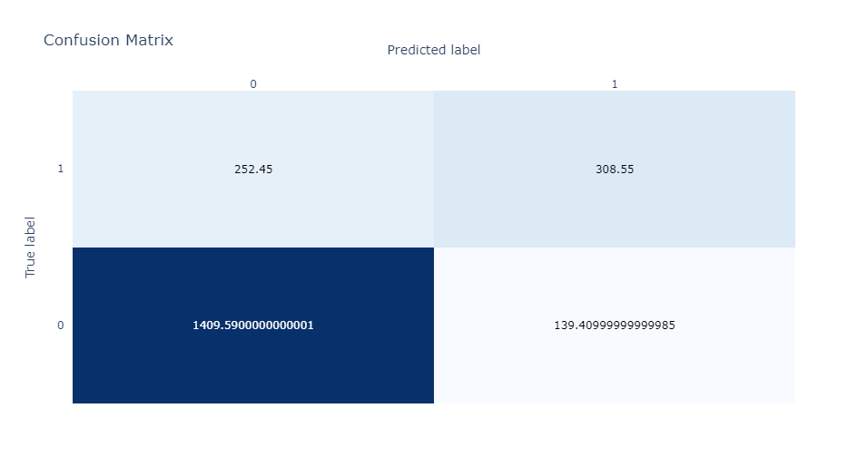
1. AdaBoost Classifier
AdaBoost Classifier
Accuracy: 0.811
Class-1 Recall: 0.55
F-1 Score: 0.61
Test Accuracy: 0.812
Mean Cross-Validation Score: 0.797
AdaBoost Classifier Confusion Matrix:

Slide 19
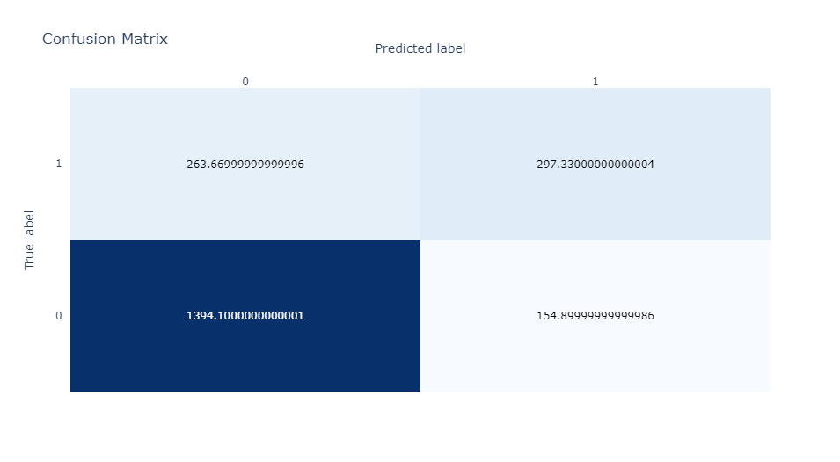
2. Random Forest Classifier
Accuracy: 0.801
Class-1 Recall: 0.53
F-1 Score: 0.59
Test Accuracy: 0.808
Random Forest Confusion Matrix:

Slide 20
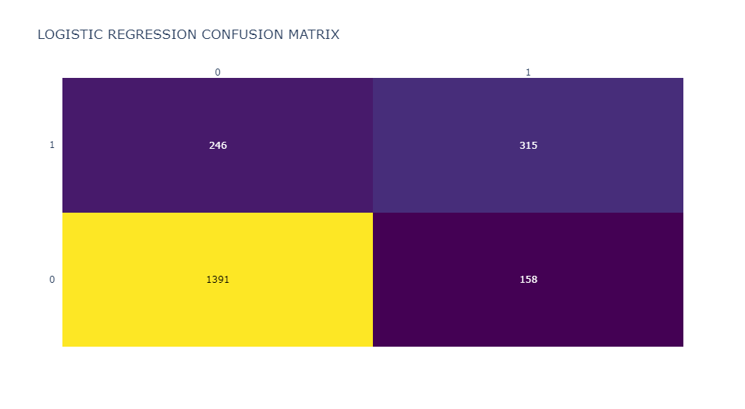
3. Logistic Regression
Accuracy: 0.809
Class-1 Recall: 0.56
F-1 Score: 0.61
Test Accuracy: 0.808
Mean Cross-Validation Score: 0.789
Logistic Regression Confusion Matrix:

Slide 21
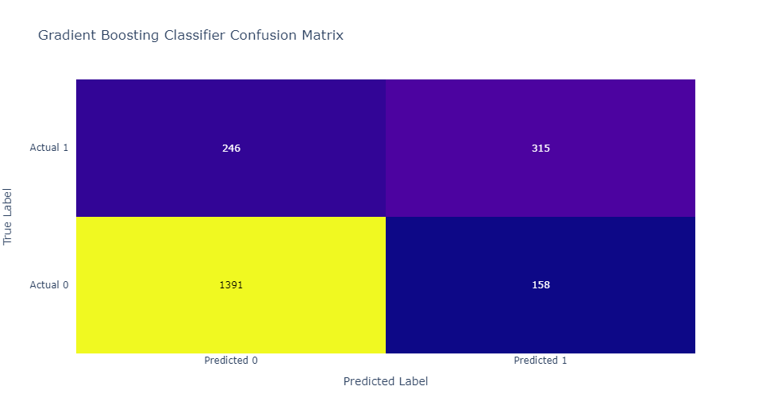
4. Gradient Boosting Classifier
Accuracy: 0.805
Class-1 Recall: 0.55
F-1 Score: 0.60
Test Accuracy: 0.808
Gradient Boosting Confusion Matrix:

Slide 22

Voting Classifier
AdaBoost currently outperforms other models in accuracy, class-1 recall, and F1 score. To achieve a more balanced approach, I combined the remaining three models using a hard voting technique in a voting classifier.
Accuracy: 0.807
Class-1 Recall: 0.54
F-1 Score: 0.60
Test Accuracy: 0.808
Mean Cross-Validation Score: 0.802
Voting Classifier Confusion Matrix:

Slide 23
AdaBoost stands out with the highest accuracy and class-1 recall among the evaluated models.
Random Forest and Logistic Regression demonstrate competitive performance but struggle in identifying positive cases accurately.
Despite its high accuracy, Gradient Boosting encounters challenges in correctly identifying positive cases.
The Voting Classifier, while offering comparable accuracy to AdaBoost, exhibits slightly lower precision and recall.
Ultimately, AdaBoost emerges as the optimal choice for this task.

Slide 24
Deployement
https://umbc-data606-capstone-imzff7tcslddf3mms63xjn.streamlit.app/

Slide 25
Conclusion
In conclusion, AdaBoost proved to be the most effective model for predicting customer churn in the telecom industry, boasting superior accuracy and class 1 recall. This highlights the significance of advanced machine learning in addressing business challenges and enhancing customer retention strategies. Leveraging AdaBoost enables proactive identification of at-risk customers and targeted retention efforts, driving business growth and enhancing customer satisfaction.

Slide 26

References
https://www.kaggle.com/code/bhartiprasad17/customer-churn-prediction/input
https://www.simplilearn.com/tutorials/machine-learning-tutorial/classification-in-machine-learning
https://scikit-learn.org/stable/modules/ensemble.html
https://www.geeksforgeeks.org/voting-classifier/
https://www.heavy.ai/blog/top-7-ways-to-optimize-customer-retention-in-the-telecom-industry

Slide 27

Thank you

